Slide 1
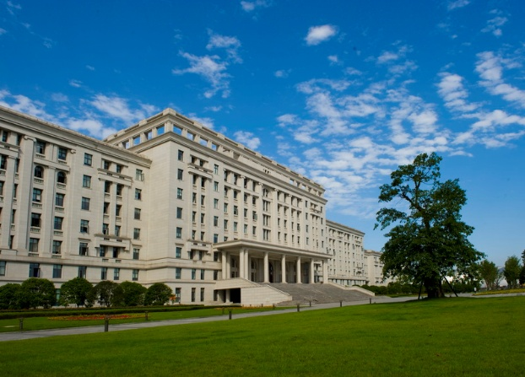
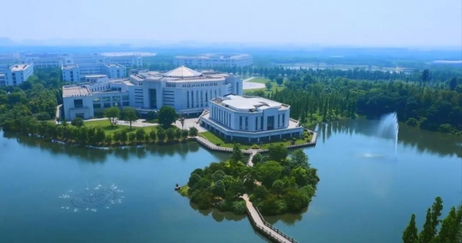

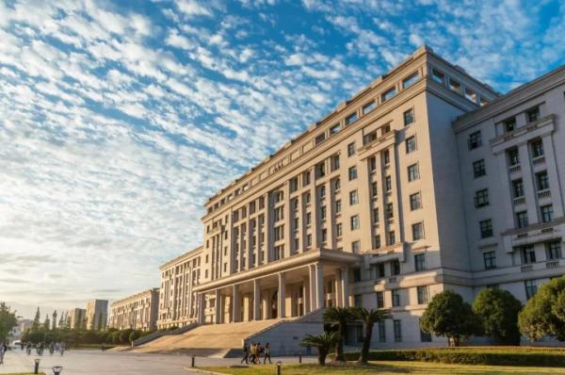
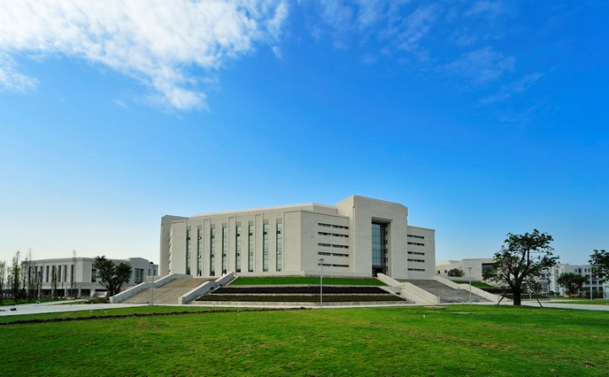

Self-attention Based Multi-model Fusion for Corporate Risk Assessment
Team: Fintech-UESTCElite
University of Electronic Science and Technology of China
Jul 23, 2021

Slide 2
Corporate Risk Assessment
01
Background
02
Model Design
Contents
03
System Architecture
04
Summary

Slide 3
Section 01
01 Background

Slide 4




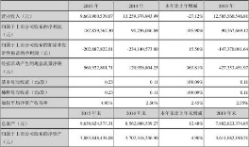

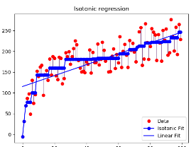

1.1 Why We Need Risk Management
Scientific Decisions
Operation Stability
Economic Benefits
Social Prosperity
Risk Management
Data
Model
Notes:
风控很重要
能带来的好处 – 1,2,3,4
风控需要的基础 – 数据 & 模型
加图像 Data、Model

Slide 5



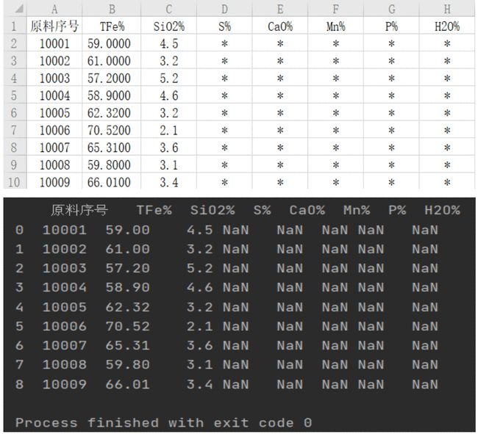


1.2 Risk Management Challenges
Cross-regional
Large Scale
Multidimensional
Data
Challenges
Incomplete Data
Entanglement
High Concealment
Notes:
改线
Data Missing 找深色图

Slide 6
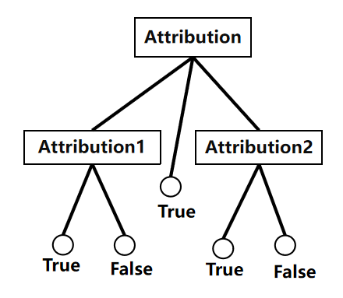
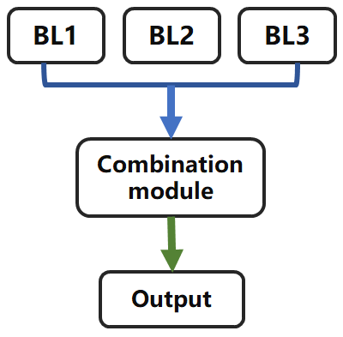
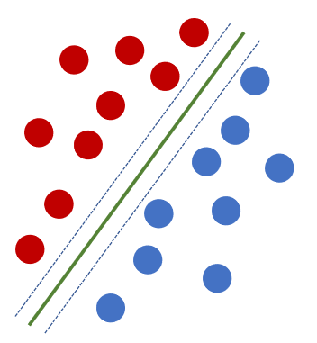
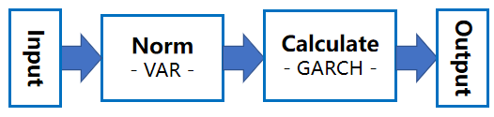
1.3 Existing Models
Financial Model
Parameter
Delta-normal
GARCH
Monte Carlo
Machine Learning Model
Decision Tree
Support Vector Machine
AdaBoost
Subjective
Simplistic
Underfitting
Poor Interpretability
Our algorithm aims to improve accuracy and performance
Notes:
金融模型 & 机器学习模型
缺点：1，2，3，4
现有算法不能解决数据的挑战，引出我们的算法模型
Ml全称 and performance
从左到右擦除
不遮挡往下拉

Slide 7
Section 02
02 Model Design

Slide 8
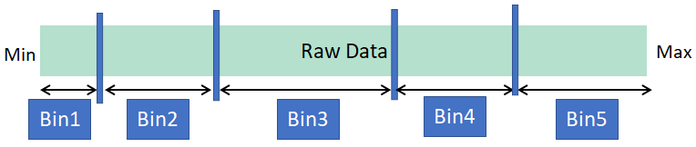

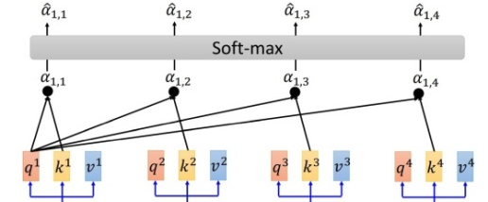
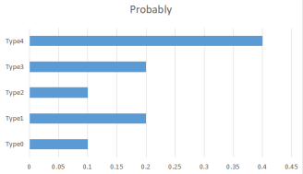
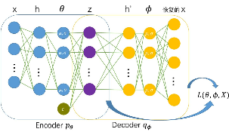
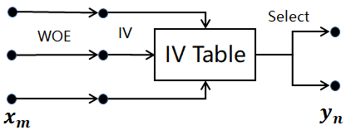
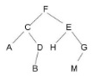
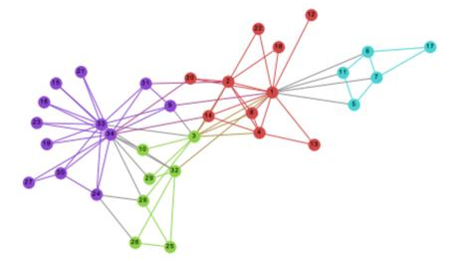
2.1 Overview
Self-attention Based Multi-model Fusion Prediction Model
Attribute Selection
N-ary WOE/IV Model
Classifier
Data
Augmentation
Self-Attention Classifier
Input
Output
Knowledge Graph
Notes:
红框开始蓝色框 轮子框出来

Slide 9
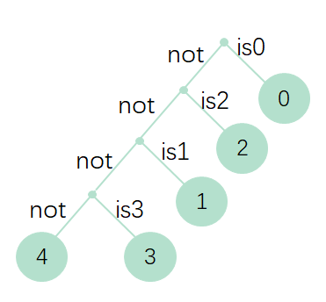
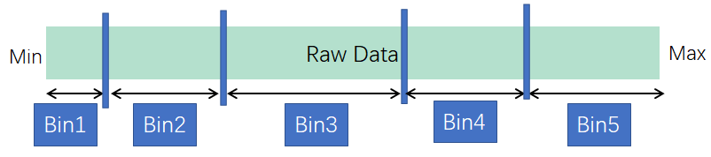
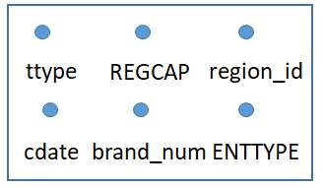
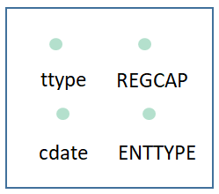
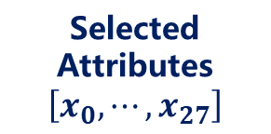
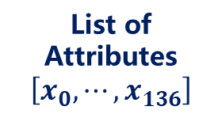
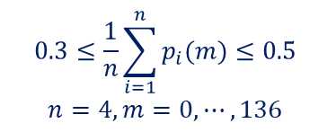
2.2 Innovation 1: Attribute Selection
WOE-IV Calculation
N-ary
Input
Output
List of Attributes
$$\left[x_{0},⋯,x_{136}\right]$$
Binning Data
Selected Attributes
$$\left[x_{0},⋯,x_{27}\right]$$
Selection
$$0.3≤\frac{1}{n}\sum_{i=1}^{n}{p_{i}(m)}≤0.5$$
$$n=4,m=0,⋯,136$$
Eliminated Data Abnormal
Solved Data Sparseness
Combined Statistic Characteristics
Good Interpretability
Notes:
排列水平居中
输入输出 外面加虚线框

Slide 10
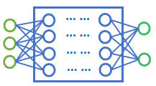

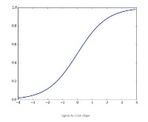


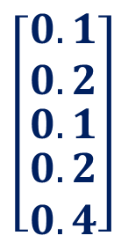
2.3 Innovation 2: Self-attention-Based Deep Classifier
MLP/CNN
Feature
Fusion
MLP
Self-attention
$$\left[\begin{matrix}0.1 \\ 0.2 \\ \begin{matrix}0.1 \\ \begin{matrix}0.2 \\ 0.4\end{matrix}\end{matrix}\end{matrix}\right]$$
Concat
Softmax
Input Data
Output Risk 4
Notes:
Self-attention 加红色轮子
颜色统一

Slide 11
2.4 Innovation 3: Hyper Knowledge Graph
Quality Evaluation
Ontology Construction
Knowledge Processing
Entity Alignment
Entity Disambiguation
Knowledge Fusion
Attribute Extraction
Relation Extraction
Named Entity Recognition
Knowledge Extraction
Knowledge Graph Construction
Notes:
虚线框：第三个 磅数1.5
实现 2.25 1.25里面

Slide 12
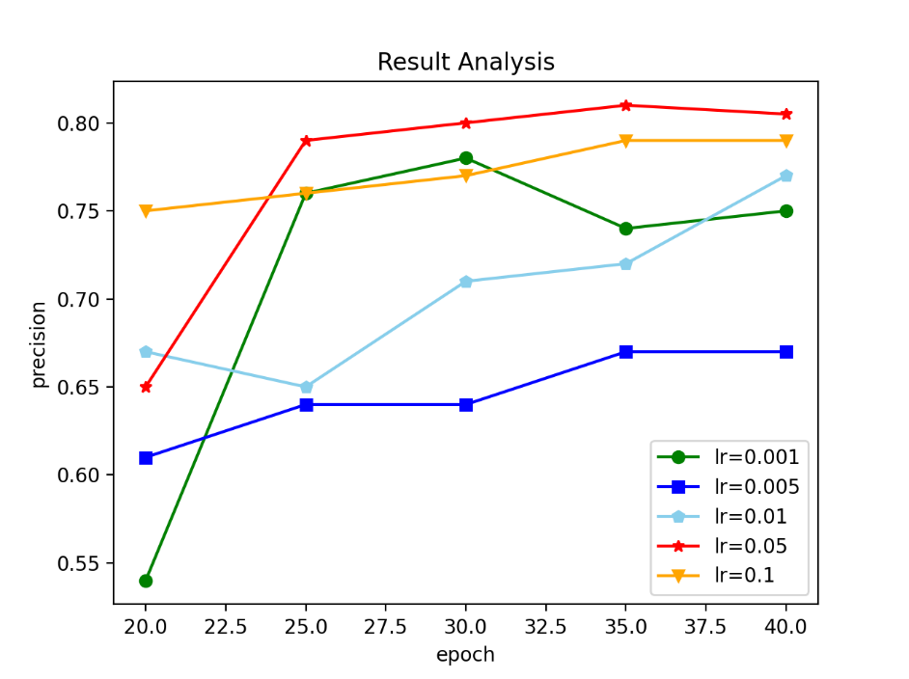
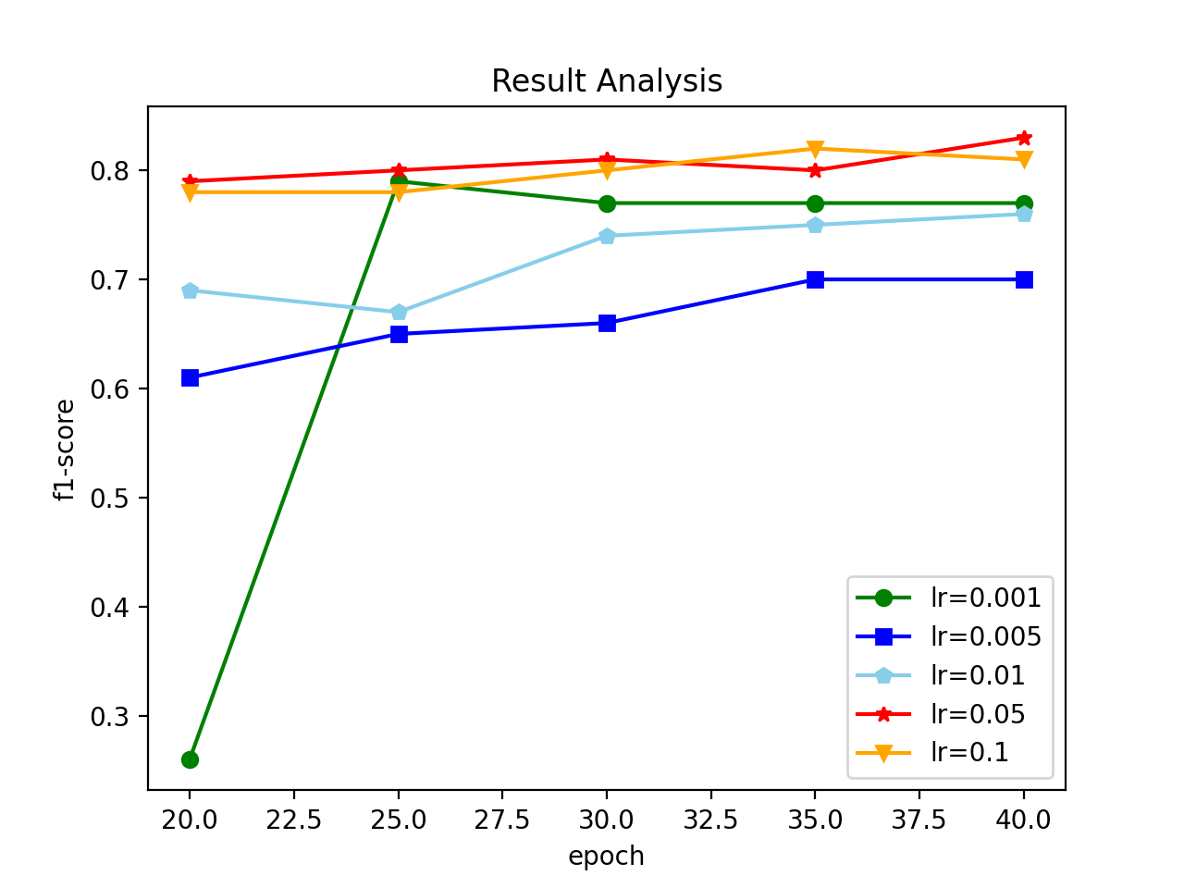
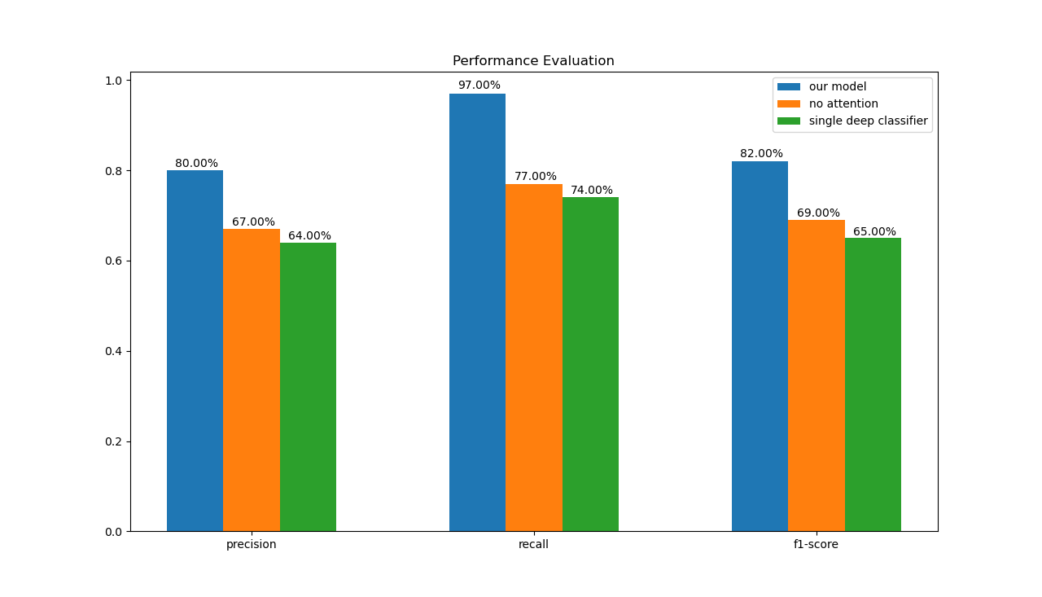
2.5 Performance
2085 Training Data
Input
137 Attributes
Ubuntu 18.04
Dataset
1392 Test Data
Data Flow
Select
28 Attributes
Configuration
Python 3.6.9
Pytorch 1.7.1
Data Augmentation
700,000 items
Output
5 Labels
LR-Precision
LR-F1-score
Model Comparison
High Performance - Precision: 0.80, Recall: 0.97, F1-score: 0.82
Notes:
数据
降为到27
数据数目（数据增强后）

Slide 13
Section 03
03 System Architecture

Slide 14
3.1 System Deployment
Application Layer
Corporate portrait
Risk Prediction
Business Analysis
Attributes Selection
Classification
Knowledge Graph
Statistics Analysis
Feature Extraction
Knowledge Construction
Business Layer
Factor Calculation
Feature Fusion
Knowledge Representation
IV Judgement
Evaluation
Optimization
Knowledge Utilization
Data Layer
Data Cleaning
Data Completion
Data Augmentation
Data Denoising
Notes:
框变填充

Slide 15
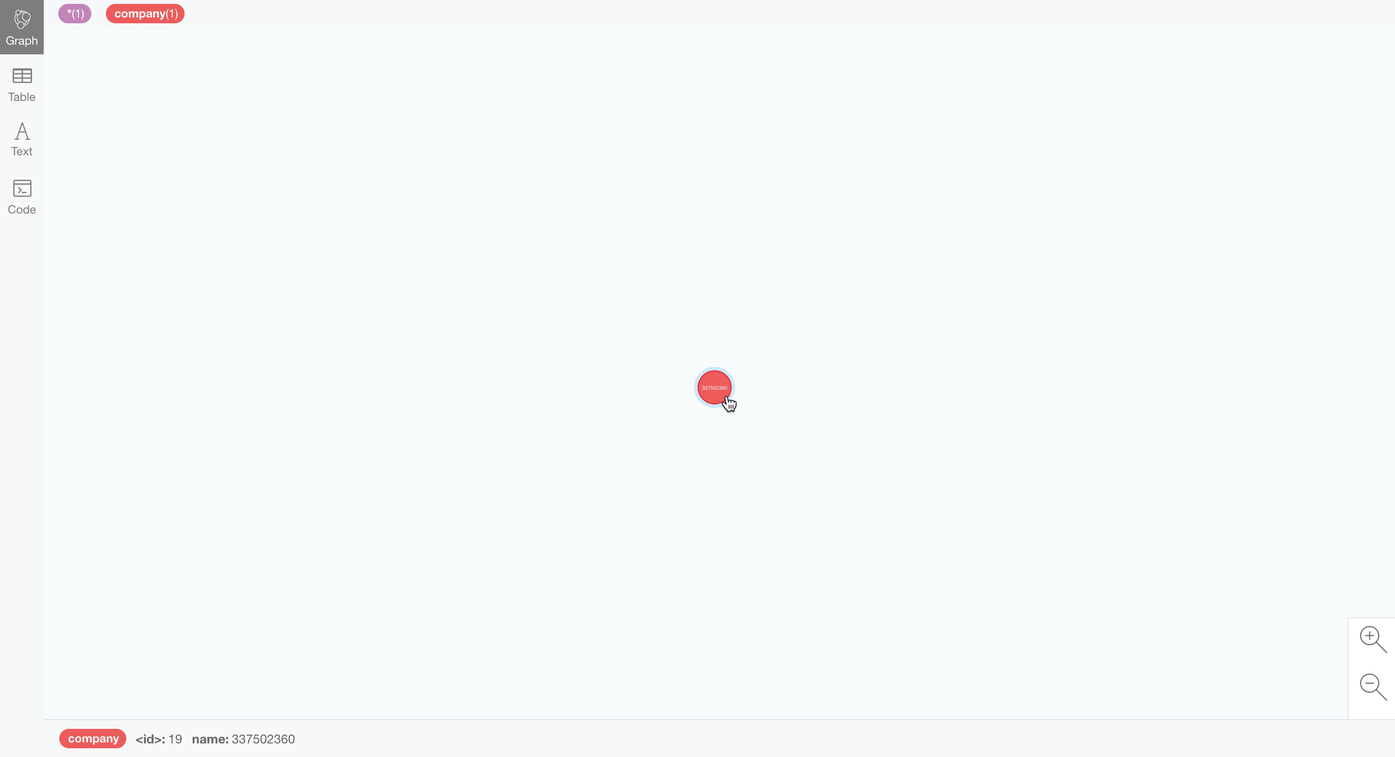
3.2 Knowledge Graph Display

Slide 16
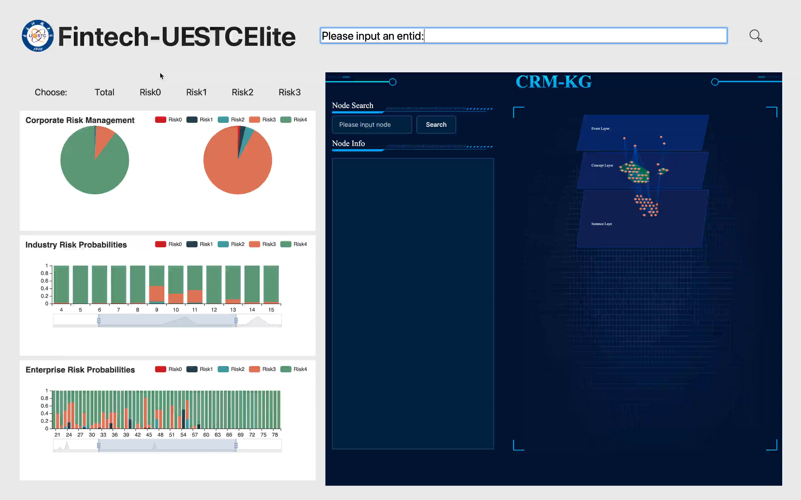
3.3 System Display

Slide 17
Section 04
04 Summary

Slide 18
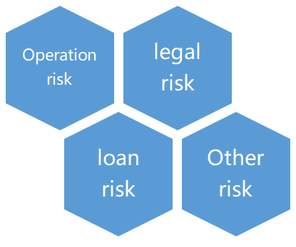
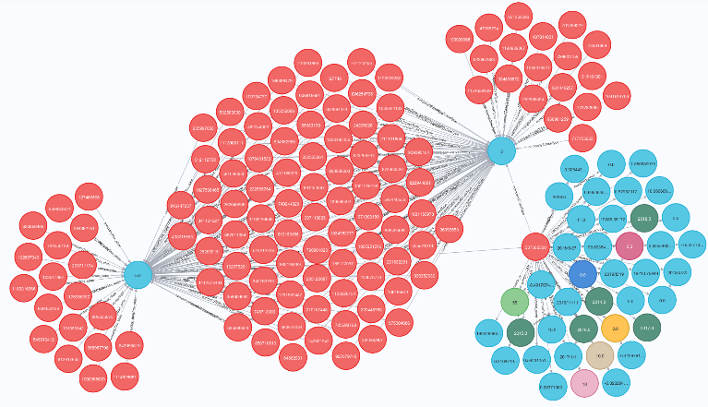
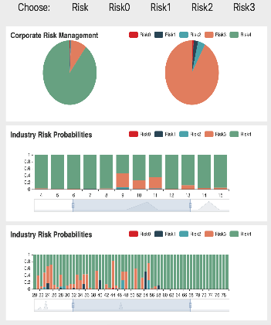
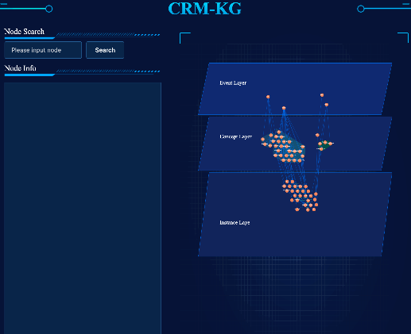
4.1 Contributions
General Effective
Accurate Classification
Good Interpretability
Friendly Interaction
Notes:
改general assessment有效的（effective）

Slide 19
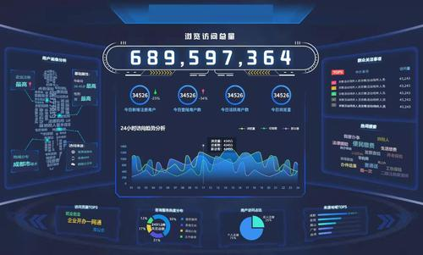
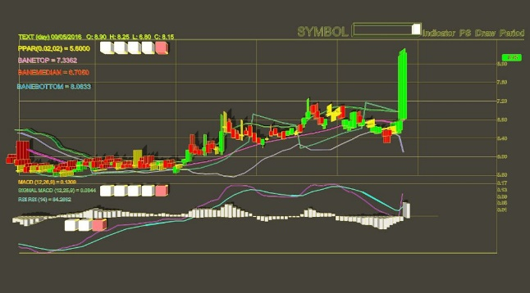
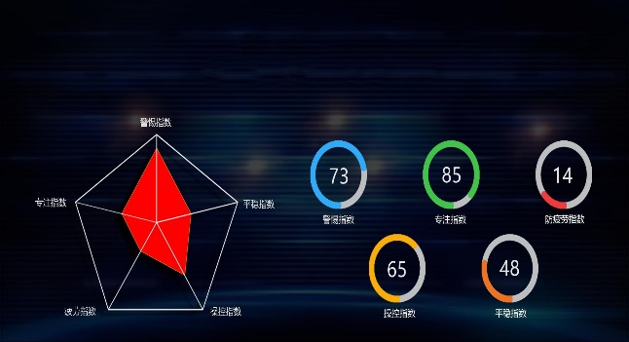
4.2 Future Work
Better Interactive Interface
Short-term and Long-term
Risk Assessment
Richer Data Dimensions
Better Results
Notes:
放几张图
改成smart

Slide 20
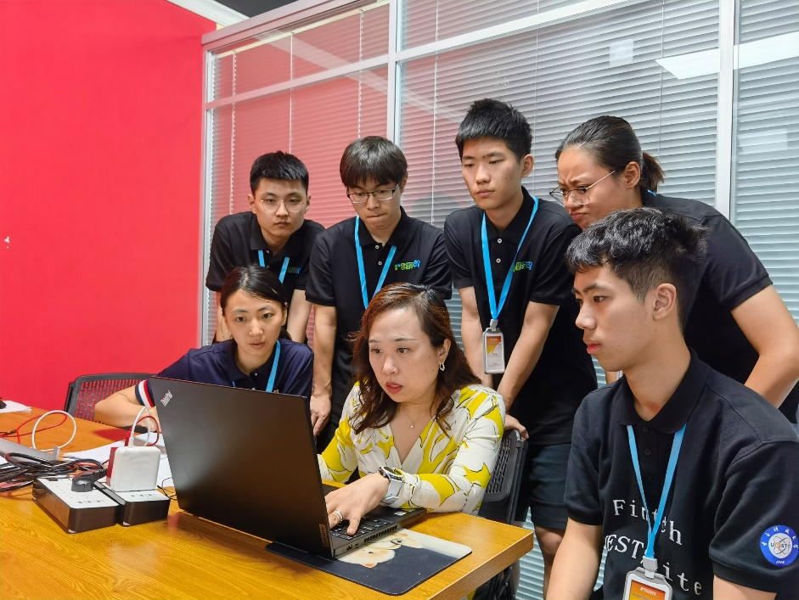
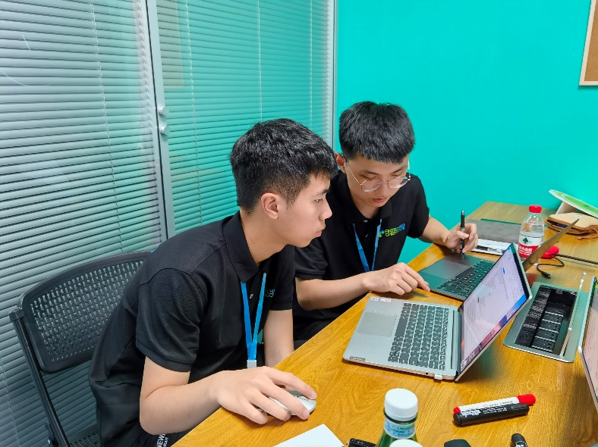
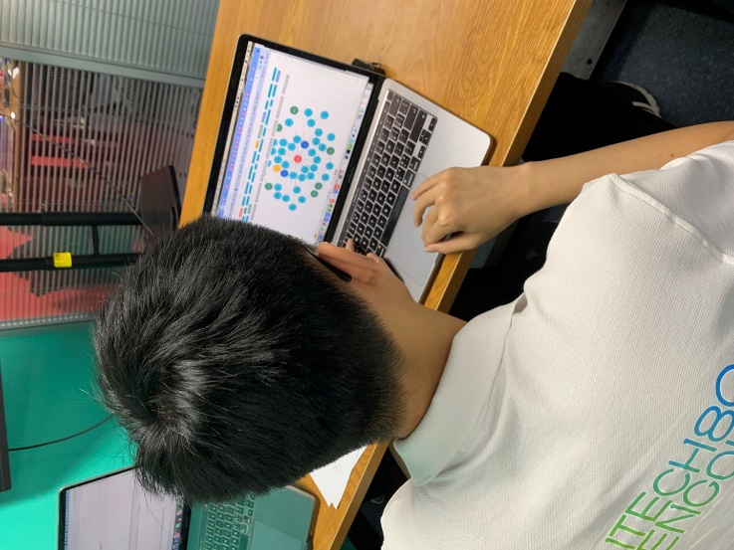
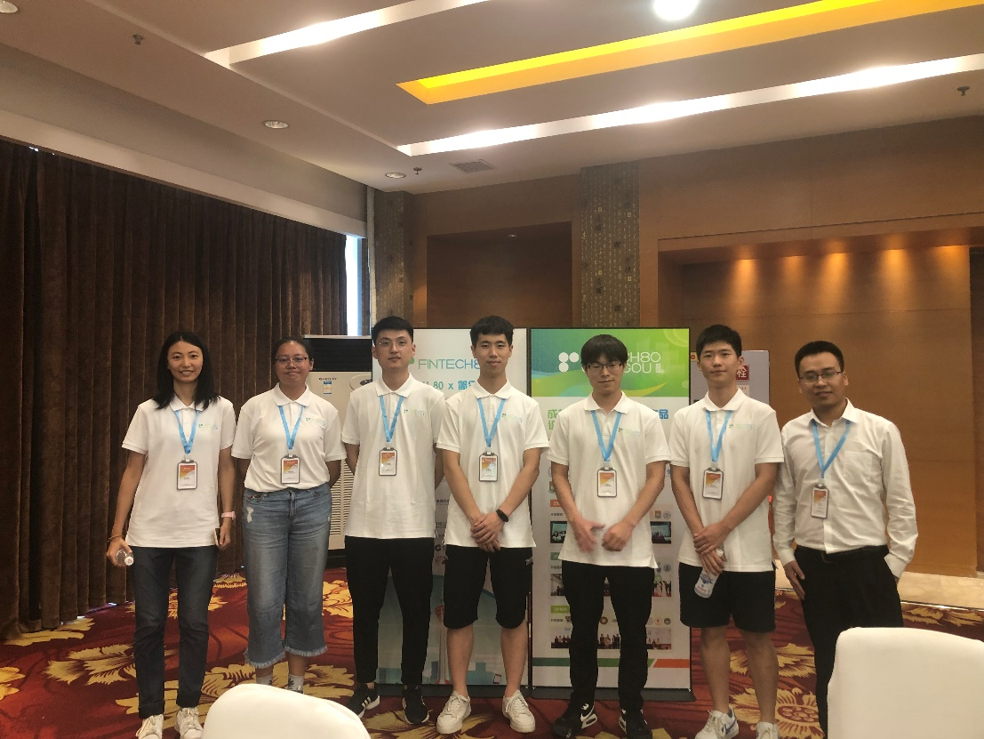
R & D Process
Struggle
Unity
Harmony
Fraternity
Notes:
好看的排版
字体大小可以不同
字体、框图颜色统一
合照、开发、指导、讨论

Slide 21

Thanks
Team: Fintech-UESTCElite
University of Electronic Science and Technology of China
Jul 23, 2021

